Slide 1
PARKING TICKETS IN TORONTO
Chiara Lu
January 25, 2024

Slide 2


On Average, the City of Toronto issues
1.95 M
Parking tickets per year
Average Annual Revenue from Parking Tickets is
$ 96.33 M

Slide 3

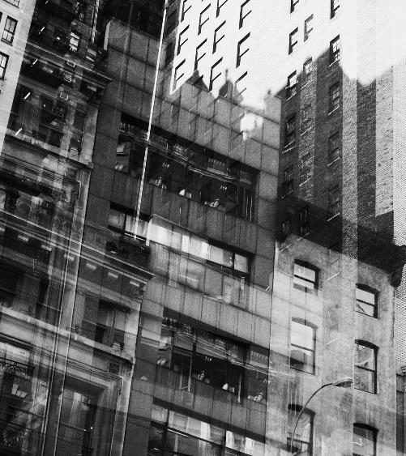
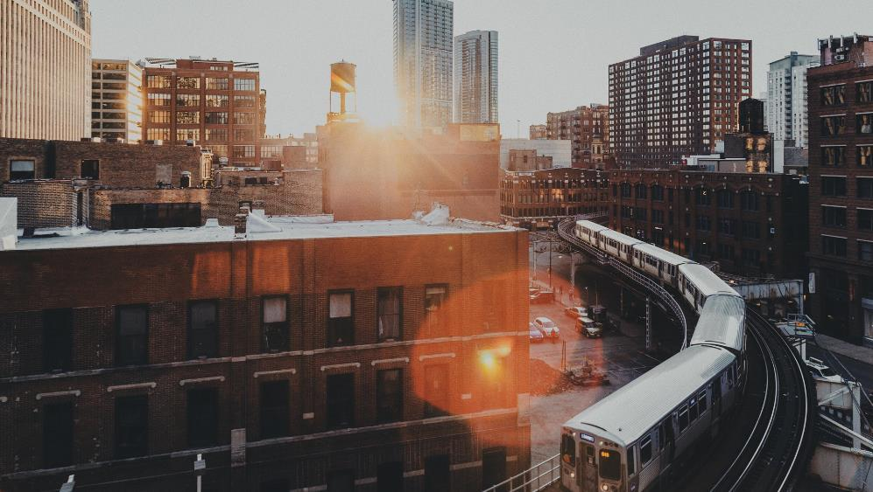
contents
The Case
The Data
Preprocessing
Dashboard Demo
Insights
Recommendations
Implementation UX
Summary

Slide 4
ABOUT THE CASE
Importance of parking regulations
External factors influencing parking behaviour

Slide 5
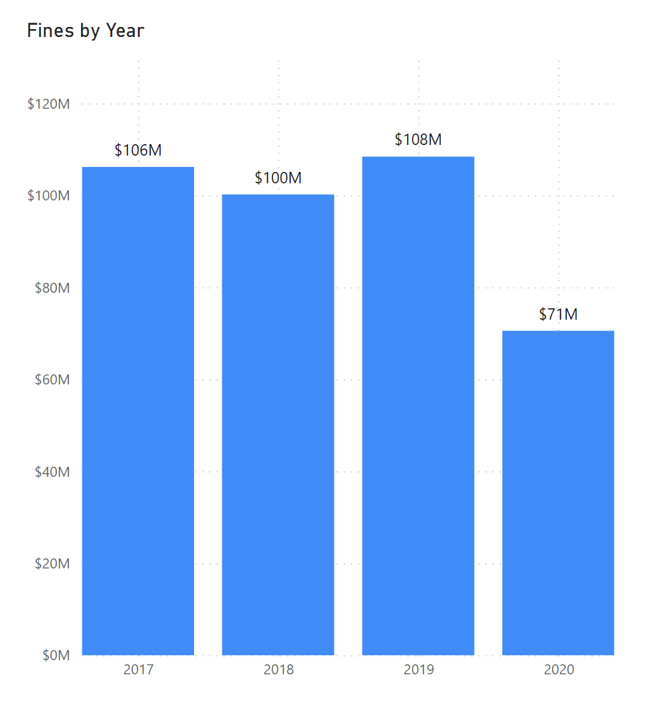
The net revenue gained depends on the balance between the income from tickets and the associated enforcement costs.
Revenue Generation
The funds collected from parking tickets can contribute to Toronto’s overall budget and help finance various public services and infrastructure.
Enforcement Costs
Costs like officer salaries, administrative expenses, and the maintenance of systems for issuing and processing tickets are incurred.
Public Perception
Excessive or perceived unfair ticketing may lead to public dissatisfaction and could potentially impact the popularity of local authorities.
Parking Regulations
City of Toronto’s net revenue from parking tickets depends on the balance between the income from tickets and the associated enforcement costs.
The city should aim to strike a balance between enforcing regulations and maintaining positive relations with the community.

Slide 6
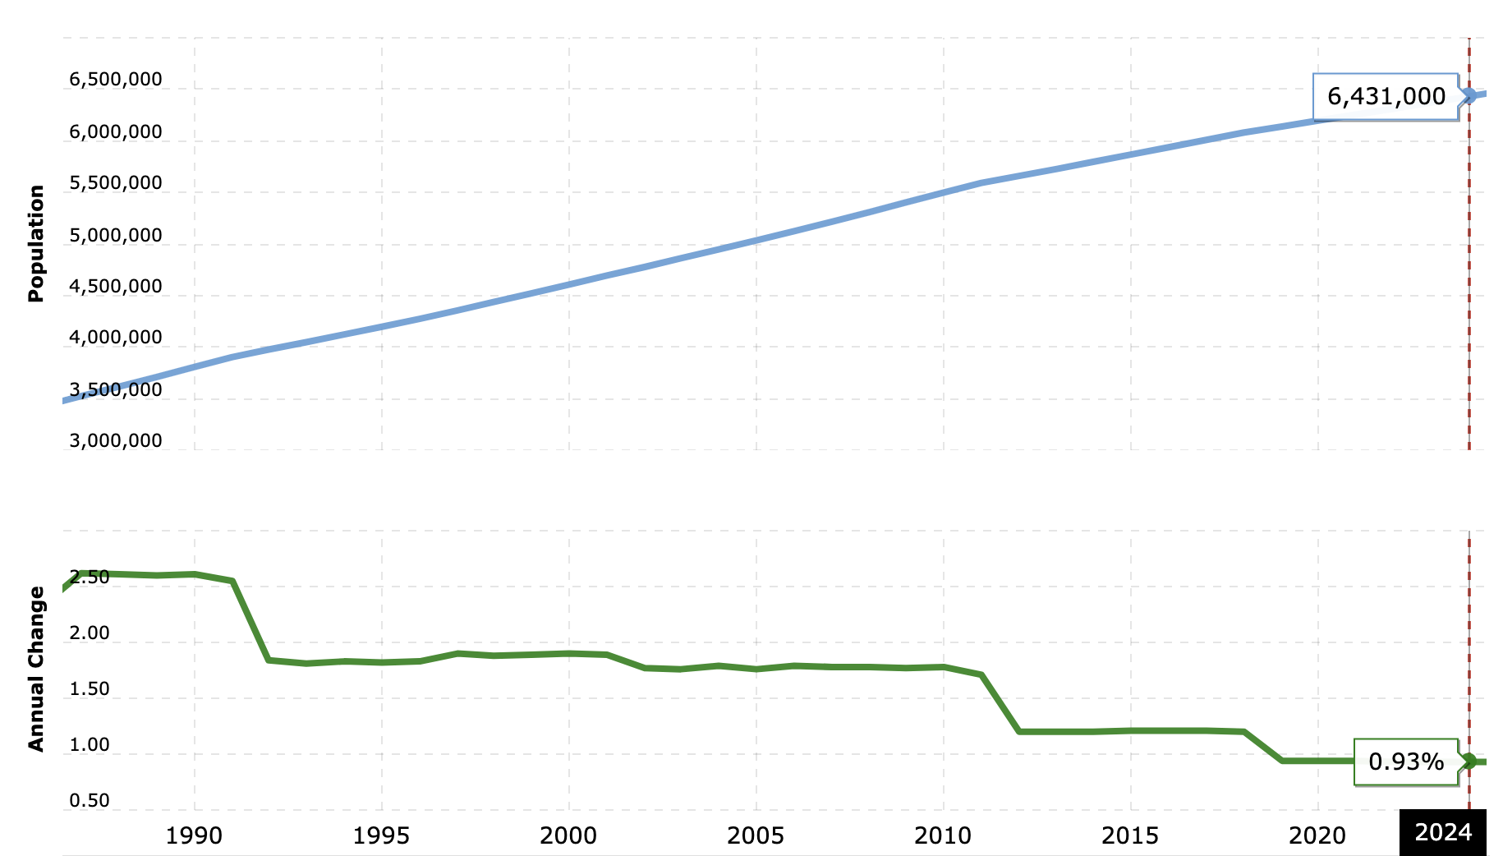
Increase in Population Size in the GTA leads to less parking spaces available
Time range of
our data
Source: macrotrends

Slide 7
ABOUT THE DATA
Raw Data
Analysis Approach

Slide 8
PREPROCESSING
​Before | After​
4 siloed zip files containing datasets | Appended tables into one master table
7,806,116 rows and 11 columns | 7,805,338 and 7 columns
Concatenated dates YYYYMMDD | Reformatted into YYYY-MM-DD
Duplicate rows | Removed duplicates
Location is stored into 4 columns | Kept ‘location 2’ as main column
Addresses are in upper case | Created new ‘location’ column from ‘location 2’ in title case
Addresses contain civic number | Dropped numeric values in address
Identified 5 meaningless columns | Dropped 5 columns
Missing values | Dropped rows with missing values
All upper cases for infraction descriptions | Reformatted into title case
Missing unique identifier | Reindexed dataset
Data types are mislabeled | Fixed infraction_code as text

Slide 9
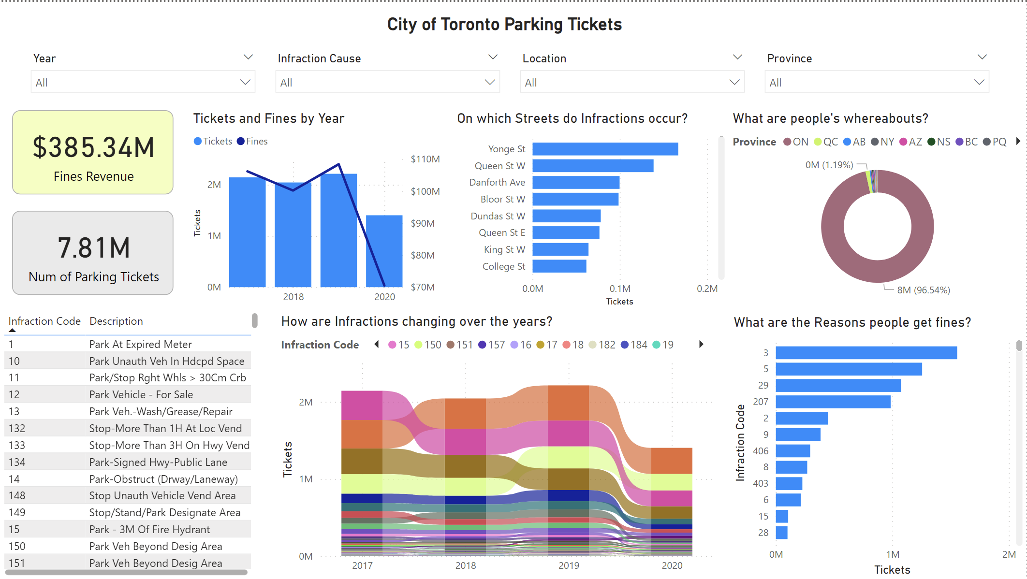
Demo
Built on Power BI
Technical specs
3 min 47 sec to refresh dataset
csv is 682.1 MB

Slide 10
insights
What is the data saying?

Slide 11
Key Findings
Total fines revenue between 2017-2020 was $385.34 M
Number of parking tickets issued between 2017-2020 is 7.81 M
Yonge St has the highest number of tickets, followed by Queen St and Danforth Ave
Parking longer than 3 hours and parking on private property are the most common reasons for being charged a parking fine
Ontario car plates received over 96% of the parking tickets

Slide 12
RECOMMENDATIONS
Welfare Growth Strategies
Solution UX

Slide 13
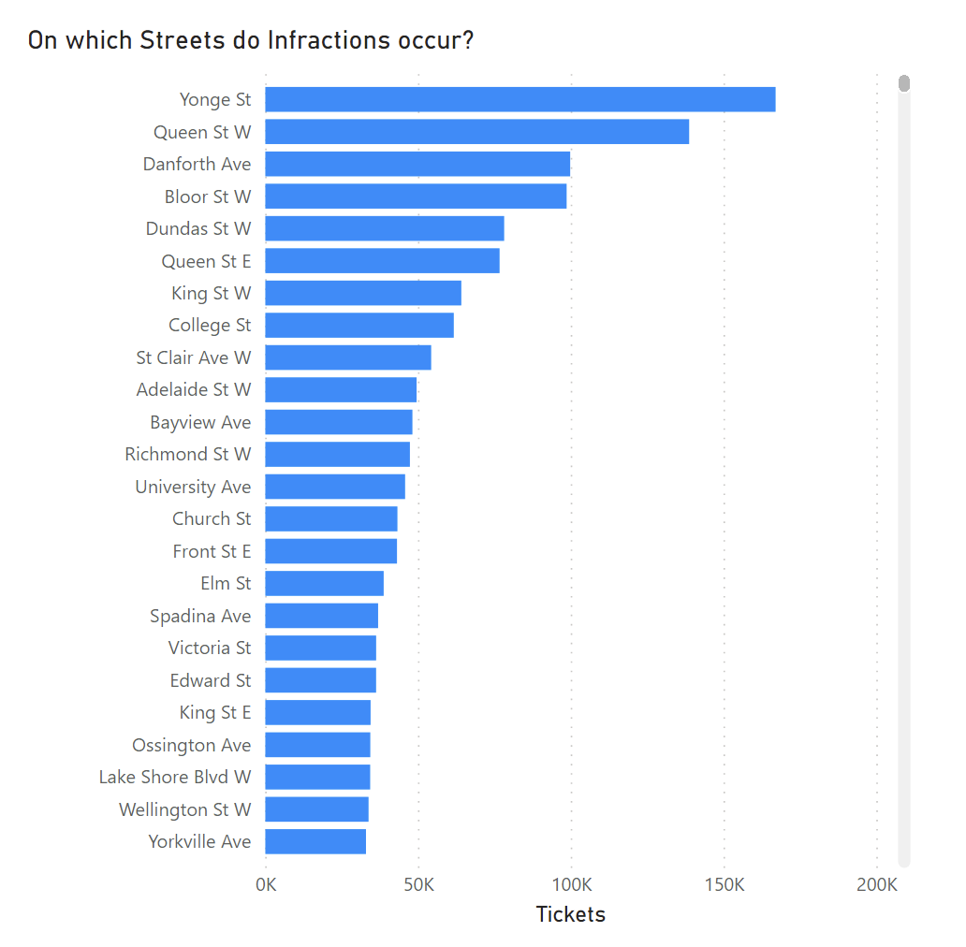
Add extra fines if the infraction occurs on a high-frequency location.

Slide 14
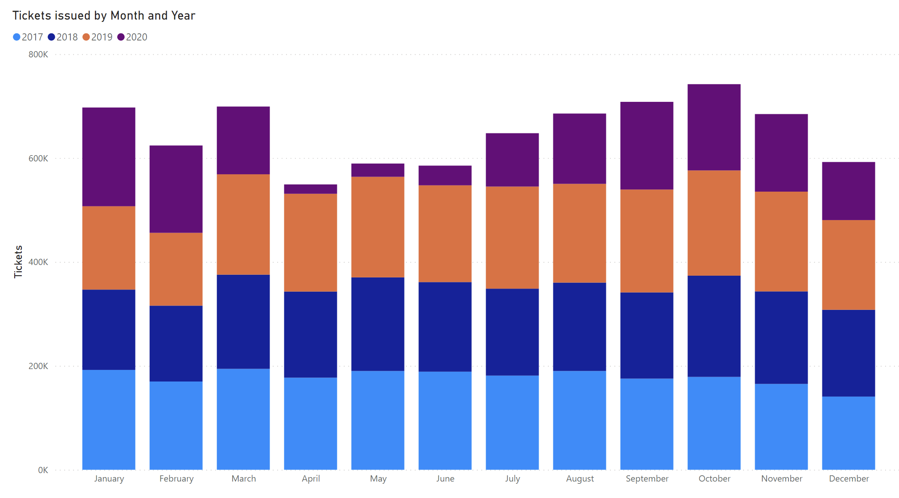
Increase number of enforcement officers during Jan, Mar, and Oct and implement rewards system for officers who increase parking ticket revenue in low-frequency months.

Slide 15
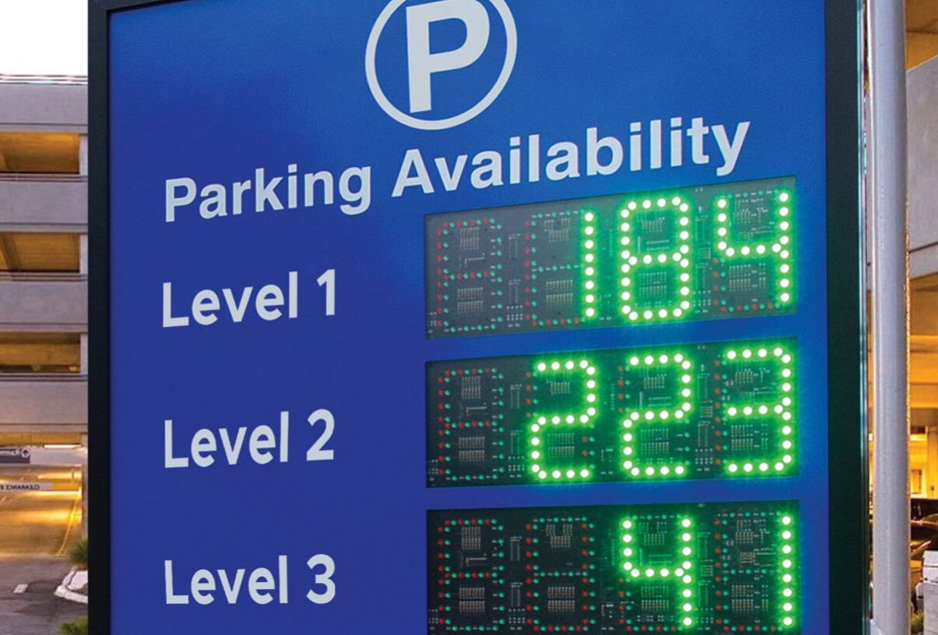
Implement Smart Parking solutions to enhance parking efficiency; allow real-time tracking of parking availability in the city.

Slide 16
Smart parking solution USER JOURNEY
Step 1
Driver inputs a destination on the Toronto Parking APP. The APP shows parking spaces and time availability.
Step 2
The driver gets to the location, pays through the smart meter for the expected parking time. The data gets stored in the system.
Step 3
The driver enjoys his time in downtown Toronto with his family.
Step 4
30 minutes before time, the APP sends a push notification reminder. If they wish to extend the time, they can pay on their phone directly without being fined.
Step 5
The driver gets back to the parking area and drives his vehicle home.

Slide 17

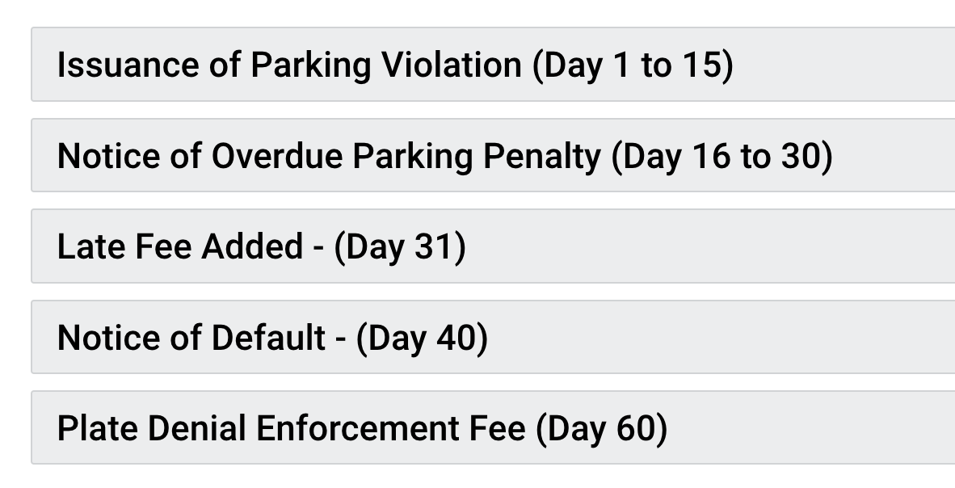

Grow awareness on the consequences of not paying parking tickets.
Unable to renew license when owing fees.
Source: City of Toronto

Slide 18
SUMMARY
ABOUT
INSIGHTS
SOLUTIONS
Enforcing Parking Regulations generates parking tickets revenue and incurs operating costs
Parking behaviour is influenced by external factors like population growth
Average annual revenue from parking tickets is $96.33 M
Average tickets issued by year is 1.95 M
Yonge St has the highest number of tickets
Parking longer than 3 hours and parking on private property are the most common reasons for being charged a parking fine
Readjust fine structure based on historic frequency
Increase number of enforcement officers and give incentives
Implement smart parking solutions with real-time data
Increase awareness on incompliance consequences

Slide 19



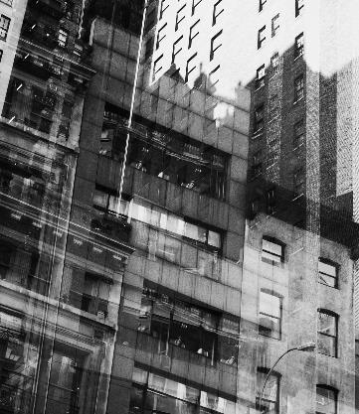


TECHNOLOGIES USED
Data collection
Exploratory
Data visualization
Data preprocessing

Slide 20
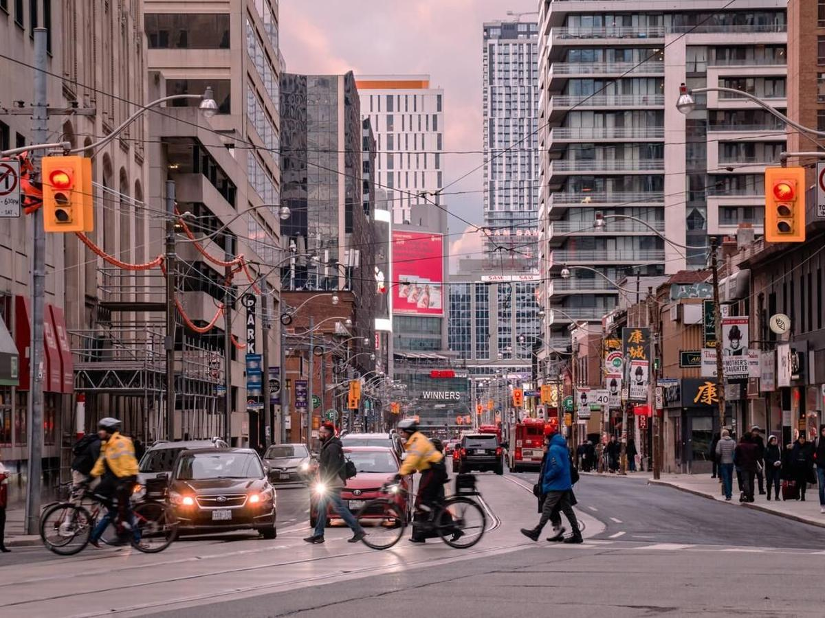
THANK YOU
Chiara Lu
chiara.lu@mail.mcgill.ca
https://www.linkedin.com/in/chiaralu/

